Slide 1
Tic Tac Toe with Reinforcement Learning
Rida Sohail

Slide 2
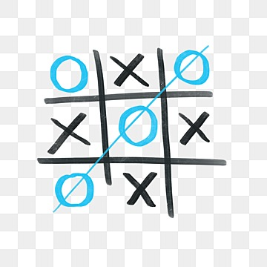
Problem Statement
Objective: Create intelligent agent
Significance: Adaptive agents
Motivation

Slide 3
Team member Roles / Goals:
Design and implementation of deep neural network
Q-Learning Algorithm for training
Fine-tuning the reinforcement learning agent
Performance evaluation and analysis
Testing by playing against an opponenet

Slide 4
Related Work vs My Implementation
MCTS | We first need to arrange the moves of the present state of the game. These moves connected together will look like a tree
Minimax | The algorithm performs a depth-first search for the exploration of the complete game tree. It proceeds all the way down to the terminal node of the tree, then backtrack the tree as the recursion.
Q-Learning | - it assign scores for different decisions given the unique states of the problem - Q stands for Quality and the Q function is the function that assigns a quality score to a State-Action pair - table consisting of all possible states on one axis and all possible actions on another axis. Each cell in this table has a Q-value.
Deep Q Learning | - Rather than mapping a state-action pair to a q-value, a neural network maps input states to (action, Q-value) pairs. - Learn from multiple transitions at once instead of a single one.

Slide 5
Approach:
Custom Environment using TicTacToe Environment class: simulate the game, keep track of the board state, determine the current player, and detect when the game was over
Q-network, implemented using the QNetwork class: It approximated the Q-values, which represent the expected future rewards for each possible action in a given state Keras framework, configured the layers, activation functions, and optimizer to optimize the learning process.
The AI agent, represented by the Agent class, interacted with the environment by selecting actions based on the predicted Q-values.

Slide 6
Training Strategy for Optimal Policy
Self play
Episodes = 10,000
Rewards: The learning algorithm aims to maximize cumulative rewards over multiple episodes
Win +1
Draw + 0.5
Lose 0
Replay Buffer: During training, I sampled experiences from the replay buffer to break temporal correlations and improve learning efficiency.
Discount Factor (gamma) = 0.9
Epsilon-Greedy approach

Slide 7
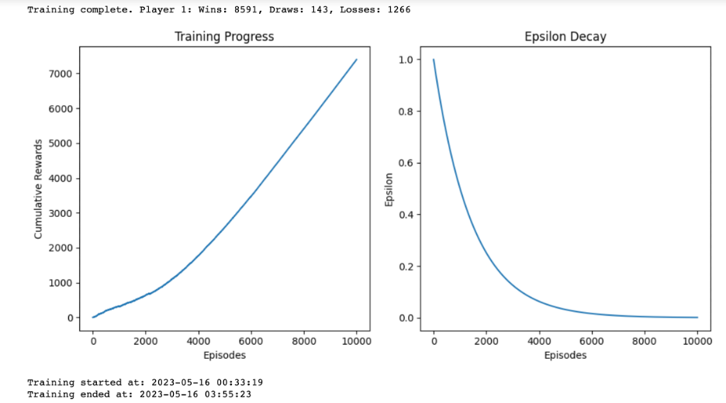
For 10,000 episodes, the agent won on an average of 85% -Vs- for 300,000 episodes, the agent won on an average of 75%

Slide 8

Experiments

Slide 9
Results
Agents | Wins | Lose | Draw
Naive | 1 | 21 | 3
Trained Agent | 5 | 18 | 2
Trained Agent with hyperparameter tuning | 15 | 1 | 9
Total games = 25
Win/Draw Percentage = 96 % (vs 90 % )

Slide 10
Lessons Learned about ML Topics
Deep reinforcement Learning
Q-learning algorithm (discount factor and Learning rate)
I iteratively refined the AI agent's training process, fine-tuned hyperparameters,
Analyzed the results by continuously evaluating to ensure steady progress
Epsilon (Exploration vs Exploitation)

Slide 11
Challenges faced and Goals not achieved
Training takes long
Improvements:
Compare result with other Reinforcement learning algorithms
Incorporate a user interface that allows human players to compete against the AI agent
Train Agent by playing against a smart agent

Slide 12
In conclusion, through the utilization of reinforcement learning and the development of a Q-network-based AI agent, I successfully created an autonomous Tic-Tac-Toe player. The agent learned to play the game strategically and achieved competitive performance.

Slide 13
Thank you!
References:
A. Singh, K. Deep and A. Nagar, "A "Never-Loose" Strategy to Play the Game of Tic-Tac-Toe,"
2014 International Conference on Soft Computing and Machine Intelligence, New Delhi, India, 2014, pp. 1-5, doi: 10.1109/ISCMI.2014.13.
GAME OF TIC-TAC-TOE: SIMULATION USING MIN-MAX ALGORITHM
International Journal of Advanced Research in Computer Science . Jul/Aug2017, Vol. 8 Issue 7, p1074-1077. 4p.
Author(s): Garg, Roopali; Nayak, Deva Prasad
Ho, Jocelyn; Huang, Jeffrey; Chang, Benjamin; Liu, Allison; Liu, Zoe (2022): Reinforcement Learning: Playing
Tic-Tac-Toe. TechRxiv. Preprint. https://doi.org/10.36227/techrxiv.20407575.v1

